Slide 1
Using the Mobile Labs
laptops and iPads

Slide 2
Items Available from the Library
12 Laptop carts (locked with key)
Each are has 32 laptops
Laptops have LanSchool to monitor student use
Laptop #1 is the LanSchool Admin Computer
1 iPad cart (padlock combination 2900)
Only 27 iPads

Slide 3
Mobile Cart Reservations - Outlook
Shared Calendars are in Outlook- add them to Favorites
You will only be able to add and edit your own reservations.
Do not schedule the lab for another teacher.
If you schedule the lab and then cannot use it, please remove your reservation from the calendar so another teacher can use that slot if needed.
We try to accommodate everyone as best we can by adding and subtracting laptops from the carts to help address need, so make sure we know what you need.

Slide 4
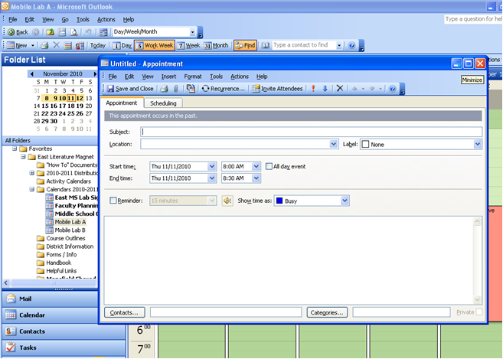
Outlook Calendar Reservations

Slide 5
Standing Reservations
Carts will be reserved Tuesdays and Wednesdays for the SS department & Mr. Luther will have a reserved cart for all B Day classes.
Cart 12 will be housed in Building B
There may be additional standing reservations and an additional cart moved to building B.
Testing will preempt all reservations.
The library will have a dedicated laptop cart for research in the library and four new desktops reserved for quick research and printing.
Don’t despair, call the library and see if we can find a cart for you.

Slide 6
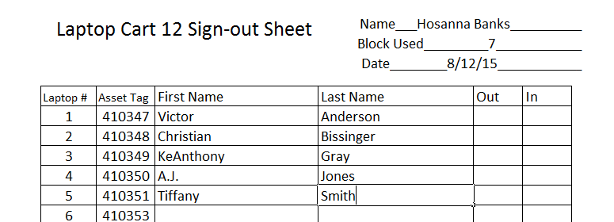
Sign-out Forms
Use the pre-made sign-out forms to assign each of your students a device prior to handing them out to students.
Please have a real mark by each name to indicate that a student actually used a computer.
If you are using blank forms please have full student names and not initials.
If a student changes laptops in the middle of class make sure to note the change on the sign-out sheet.
More info on the sheet is better.

Slide 7
Cart Pick-up
Library in Building A
Room 108 in Building B
DO NOT send students to pick up or
return the cart. If you can’t get it to the library or Rm 108
yourself just call we’ll work it out.
Keep the key and combination in a safe, non-accessible
location at all times while the cart is in your possession.

Slide 8
Verify that all devices are present
It’s a very good idea to check the status of your cart when you pick it up. Are all devices present?
All 12 laptop carts have 32 computers.
iPad Cart A has 27 iPads
We will strive to have a note taped in the cart if a device has been removed for repair. (We are not perfect and this is a rapidly moving target.)

Slide 9
In Your Room
When you get the cart to your room, plug the power cord(s) into an outlet.
Keeping the cart plugged in ensures that any devices not being used in your class will continue to be charged and ready for teachers needing to use it during other class periods.
Keep carts locked at all times. Students should not have free access to the carts.

Slide 10
At the end of class
Return the devices to the cart.
teacher oversees the collection and return of devices to the cart.
Perform a visual inspection of EVERY laptop to ensure that none have been damaged or vandalized and that all are POWERED OFF (no blue lights appear). (I find laptops still logged into student accounts regularly. If an account is left open ANYONE can access their data. Remind them how important it is to log off/shutdown.
Do not hold the power button down to force the laptop to shut off. They need to fully shutdown on their own. Multiple forced shutdowns cause corrupted hard drives.
Return laptop to the cart and plug it in.
iPads may remain on.

Slide 11
Log off vs Shutdown
Logging off closes the current account.
Faster for the next student to logon.
Over Night updates can occur
Shutdown ensures there are no student accounts open
Keeps the laptops cooler
No updates

Slide 12
Returning Carts
Lock the cart
Return the cart to the HS – library by 3:15
Return the key and Sign-out sheets.
Make notes on the sign-out sheets
of any issues. Be as specific as possible.
These notes will be used for troubleshooting and helpdesk tickets.

Slide 13
Student Accounts
All student passwords have been reset to the student ID number (190……).
You can reset their accounts and passwords from your computer.
All students have access to Office 365 http://email.mnpsk12.org

Slide 14
Laptop Troubleshooting
Things you can try to fix:
“No logon Server” – plug the laptop into the wall jack with an Ethernet cord and sign in
“Low resources” – restart three times, this will erase the cache.
Things you can’t fix:
Problems with the “trust relationship” – bring it to the library
Black Screen with crazy words and numbers- corrupted hard drive , bring to the library
If it cycles through the repair screen- bring to library

Slide 15
Technology Hints Handout
I will be sending you a handout with this and other important information on it.
Keep It.

